Slide 1
input
process
output
storage

Slide 2
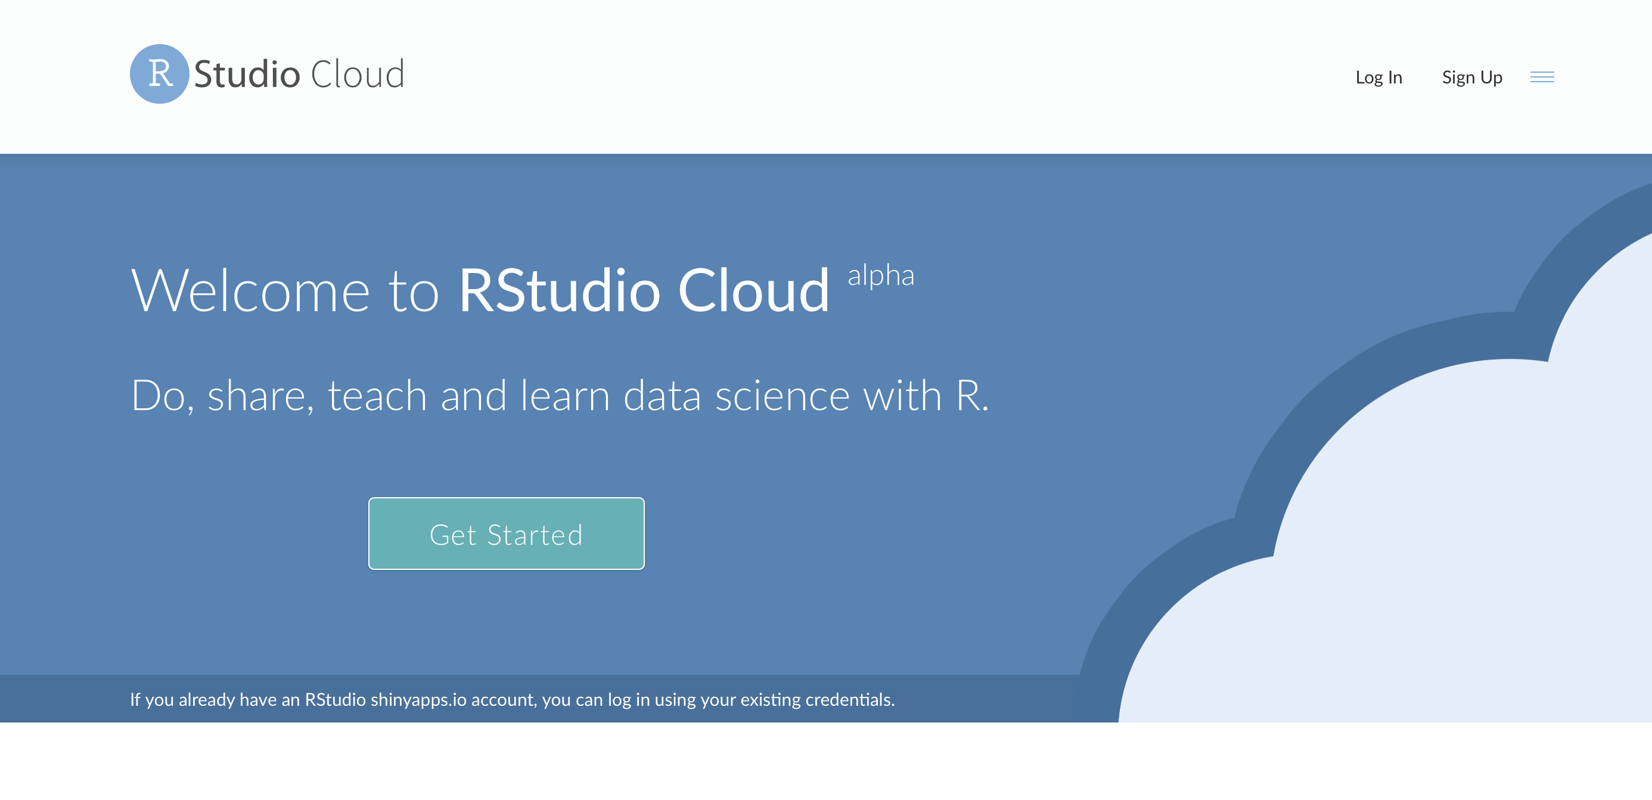
(1) Create your account on https://rstudio.cloud and login

Slide 3
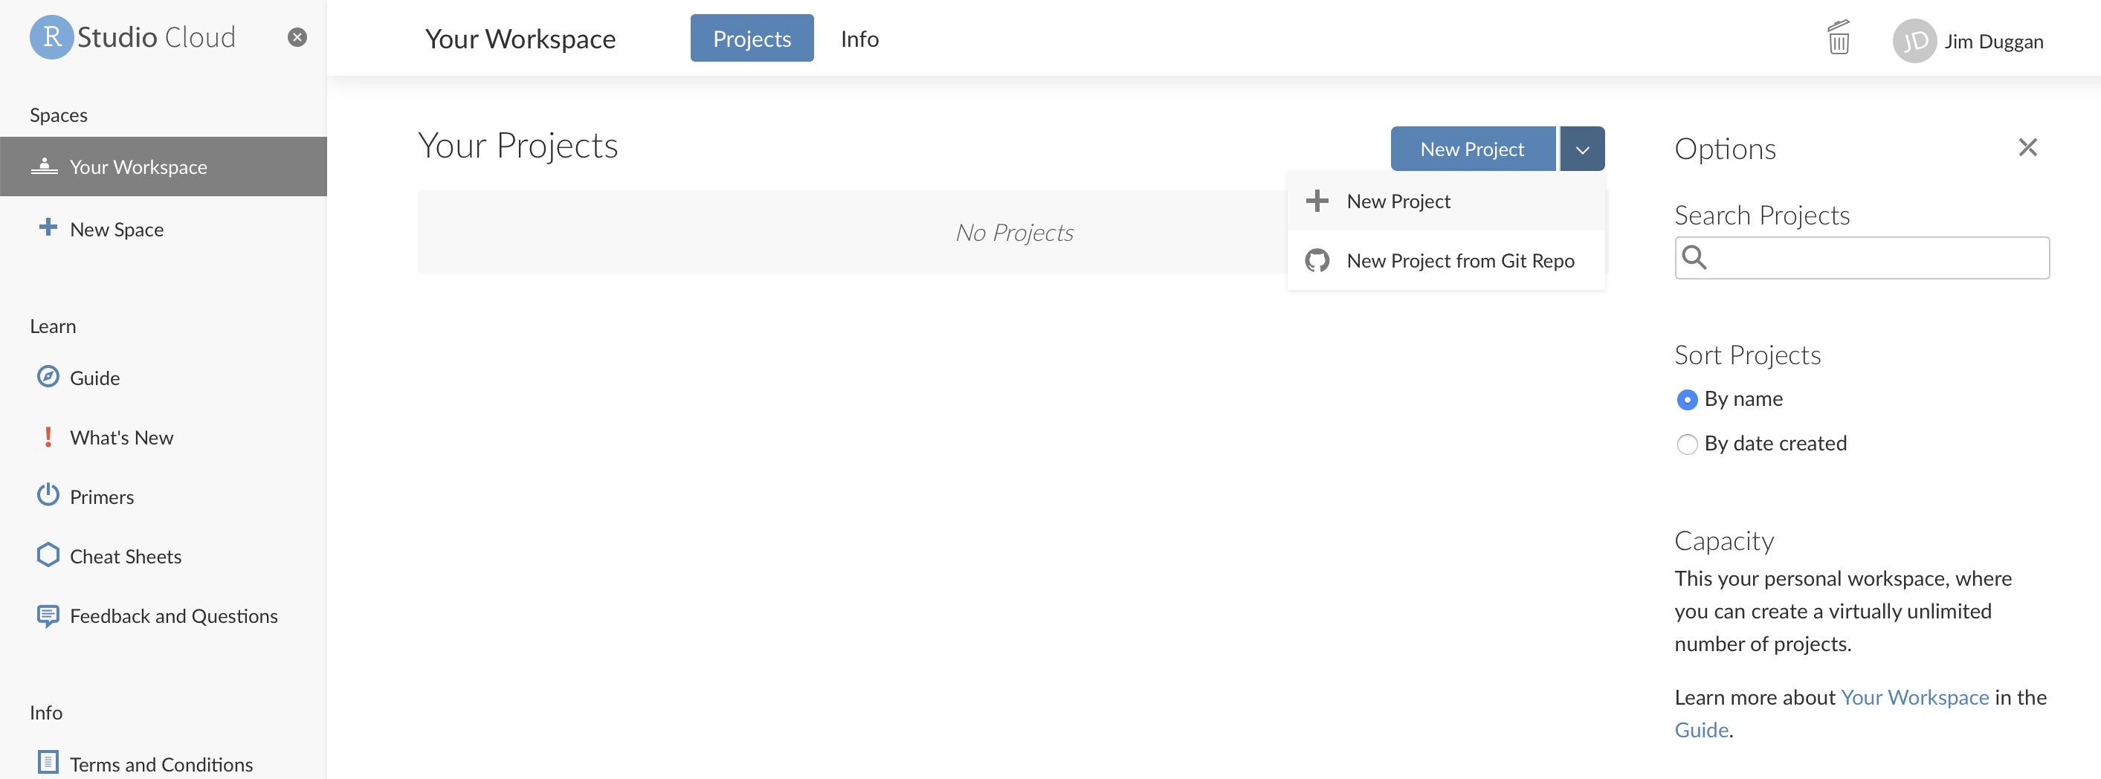
(2) In your workspace, create a project

Slide 4
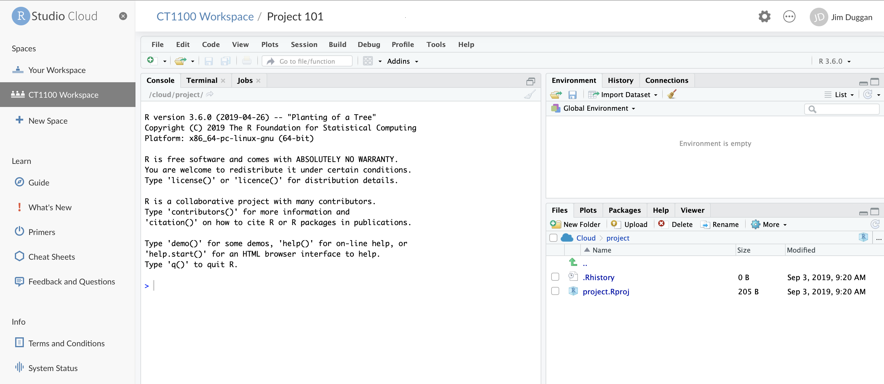

Slide 5
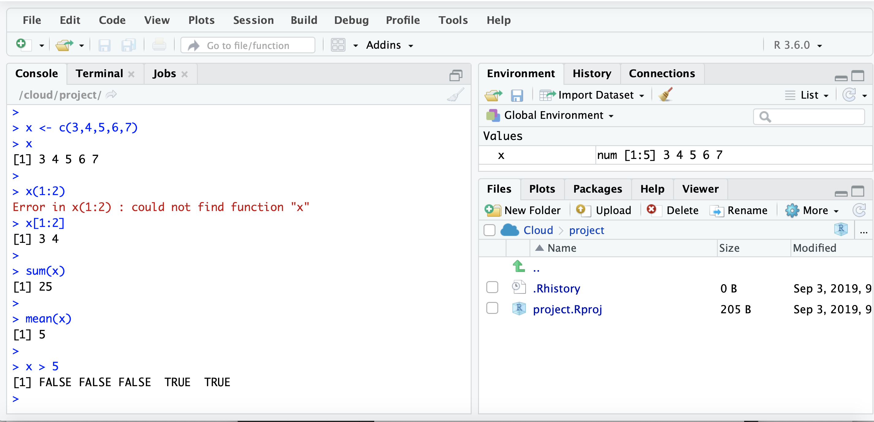
(4) Name the project (e.g. R Course)

Slide 6
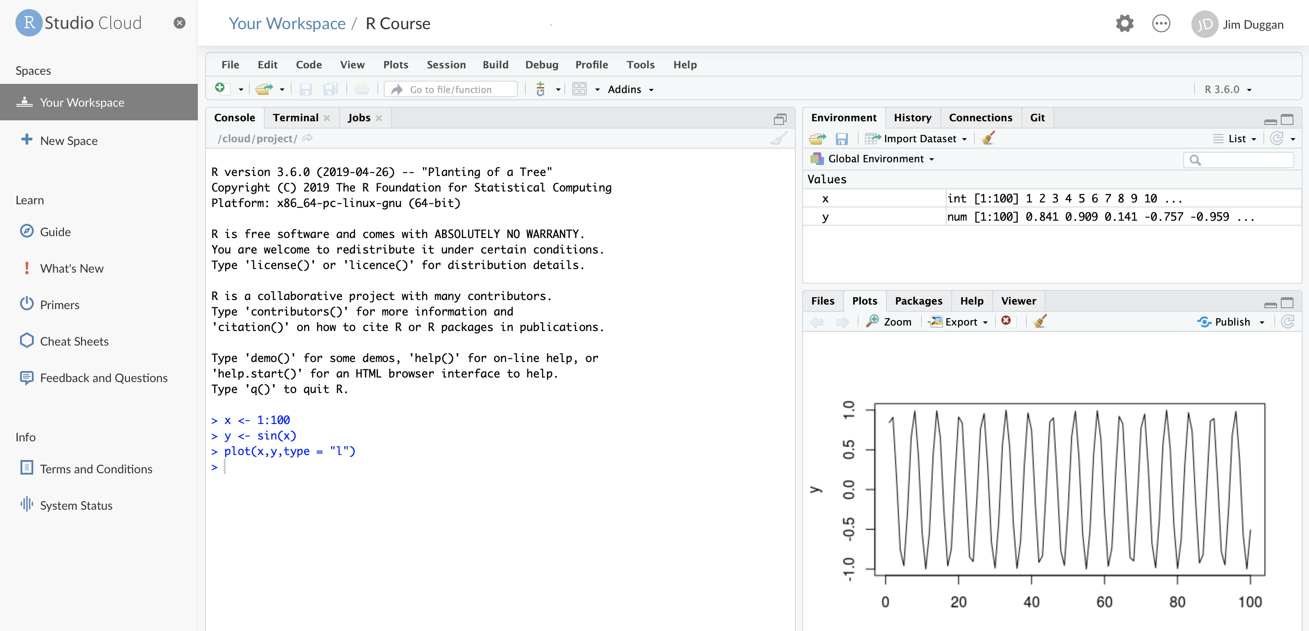
(5) Run some R code in Console

Slide 7
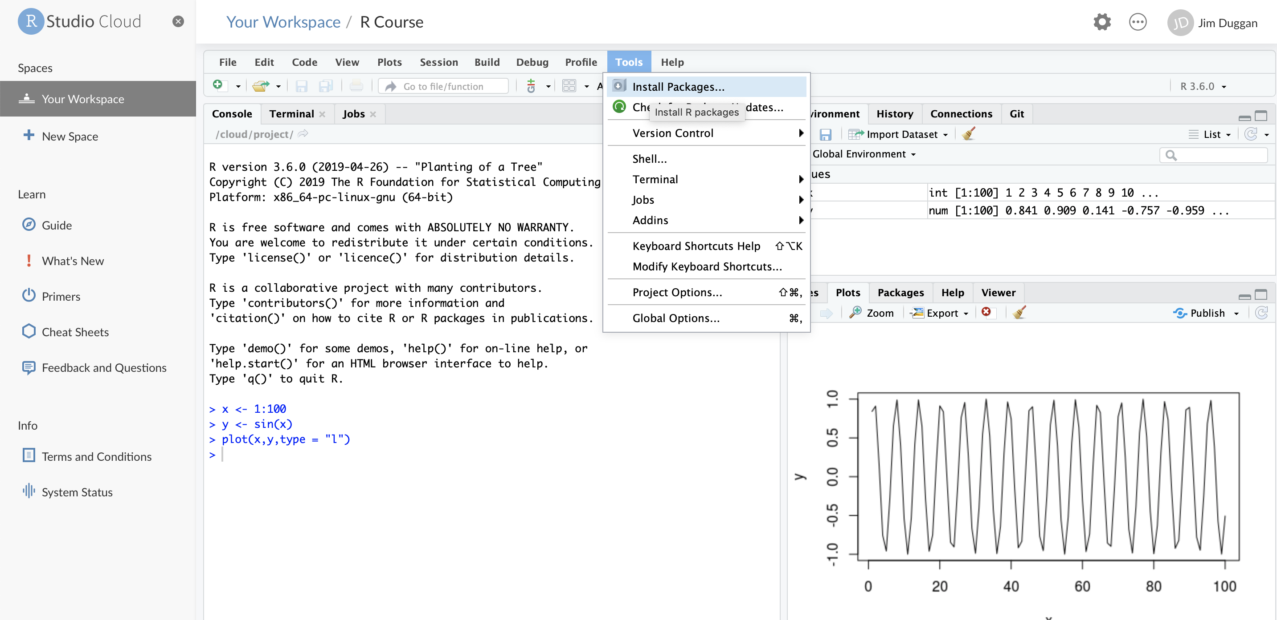
(6) Install required packages

Slide 8
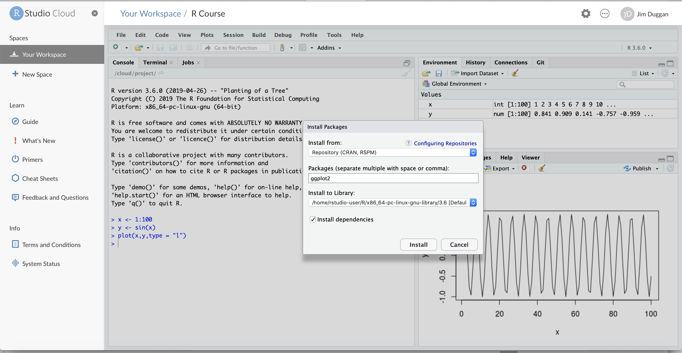
(7) For example, ggplot2

Slide 9
(8) Sample Packages required
Package | Purpose
ggplot2 | Produce graphics for data
dplyr | Analysis of data held in tibbles/data frames
tidyr | Tidy data in order to make it suitable for processing
readxl | Read Excel worksheets into R (as tibbles)
purrr | Apply functions for processing lists
ISLR | Data for text book Introduction to Statistical Learning with Applications in R
MASS | Functions and datasets to support Venables and Ripley, ``Modern Applied Statistics with S'' (4th edition, 2002).

